Slide 1
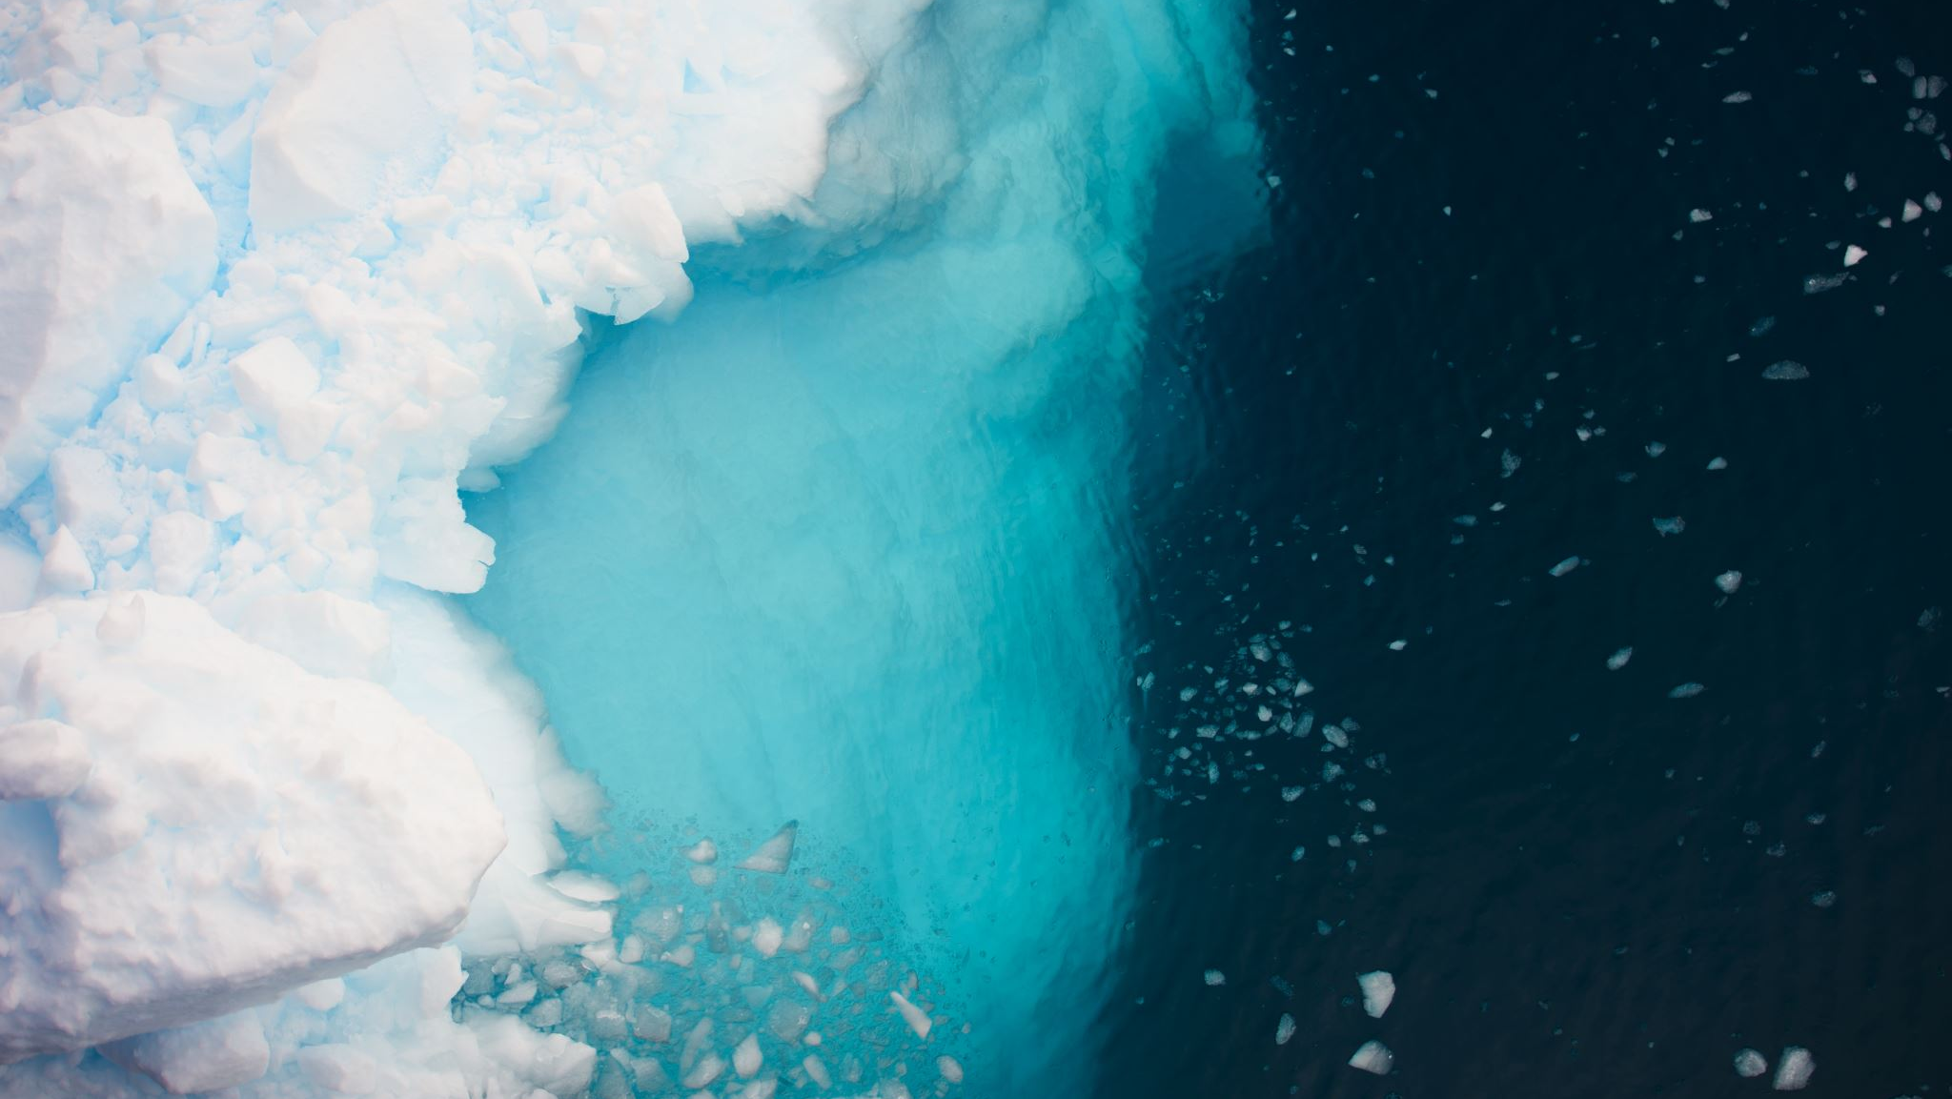

Slide 3
Gradient Direction
Gradient Magnitude
80 | 36 | 5 | 10
37 | 9 | 9 | 179
87 | 136 | 173 | 39
76 | 13 | 1 | 168
2 | 3 | 4 | 4
5 | 11 | 17 | 13
11 | 21 | 23 | 27
23 | 99 | 165 | 135
 | 3 |  |  | 2
0-19 | 20-39 | 40-59 | 60-79 | 80-99 | 100-119 | 120-139 | 140-159 | 160-179
Histogram

Slide 4
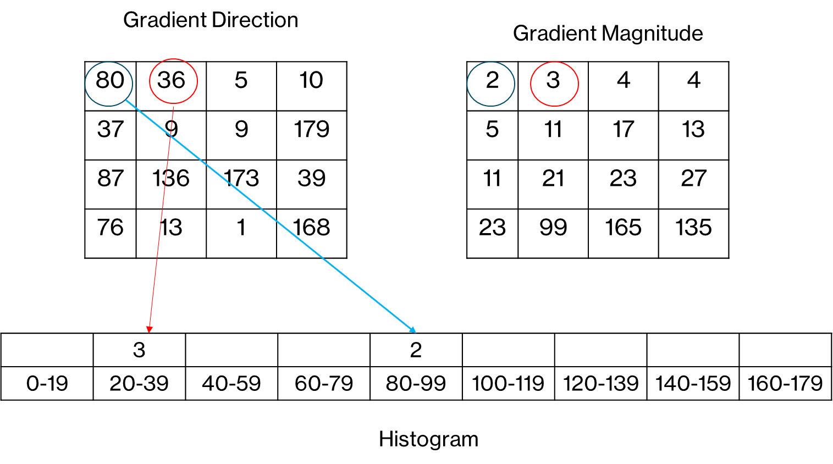

Slide 5
